Slide 1
FINANCIAL RECONCILIATION & MONTHLY CLOSING
LedgerSight
From Transactions to Control
An end-to-end Excel analytics build that reconciles revenue, payments, and delivery performance for an e-commerce marketplace — turning three raw transactional tables into a governed monthly-close dashboard.
Excel
Power Query
Power Pivot
DAX
PivotCharts
Dashboard
Olist E-Commerce Dataset · Excel-Only Build · Competition Edition, 2026

Slide 2
EXECUTIVE SUMMARY
One Story, Eight Steps
Three raw transactional exports become a live monthly financial-control dashboard.
1
2
3
4
5
6
7
8
Raw Data
Cleaning
Transformation
Data Model
DAX Measures
KPIs
Dashboard
Business
Decisions
Verified Headline Results
$15.74M
98.0%
101,687
7,981
TOTAL REVENUE
RECONCILIATION
TOTAL ORDERS
LATE DELIVERIES
Delivered orders · $15,744,351.79
Actual vs. Expected Revenue
Processed in the master table
Avg. delay 9.6 days
The dashboard reconciles what the business earned against what it expected to earn, tracks payment accuracy across four payment types, and flags delivery-performance risk — refreshed from three linked source tables with a single click.
LedgerSight
02

Slide 3
DATA FOUNDATION
Three Source Tables, One Key
olist_orders_dataset
olist_order_items_dataset
olist_order_payments_dataset
101,687 rows (master)
98,666 rows (aggregated)
101,683 rows (aggregated)
KEY COLUMNS
KEY COLUMNS
KEY COLUMNS
order_id · customer_id · order_status · order_purchase_timestamp · order_approved_at · order_delivered_carrier_date · order_delivered_customer_date · order_estimated_delivery_date · Month_Year
order_id · total_price (Σ price) · total_freight (Σ freight_value) · item_count
order_id · payment_type · total_payment (Σ payment_value)
Backbone of the model — every order's lifecycle dates and status. All calculated columns and DAX measures are built on top of this table after the merge.
Grouped by order_id in Power Query before joining, so each order carries one row of item value instead of one row per line item.
Grouped by order_id to sum multi-installment payments, then merged in to compare what was actually paid against what was expected.
Left Outer Join
Left Outer Join
How They Connect (joined on order_id)
Master Table
101,687 rows · 20 cols
Orders
(master)
Items
(aggregated)
Payments
(aggregated)
+ DateTable joined on Month_Year
LedgerSight
03

Slide 4
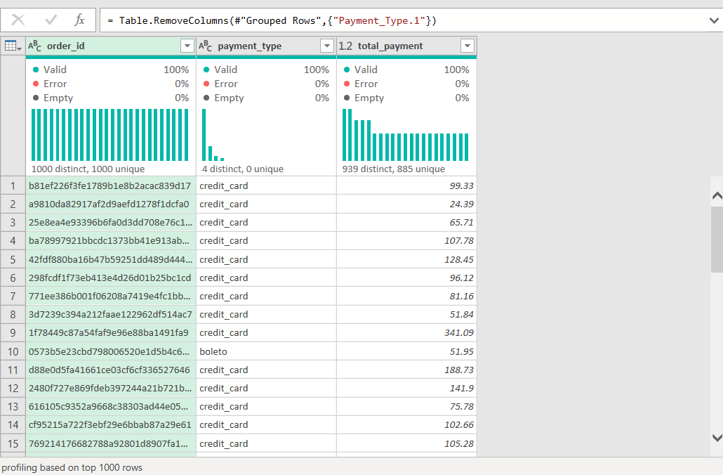
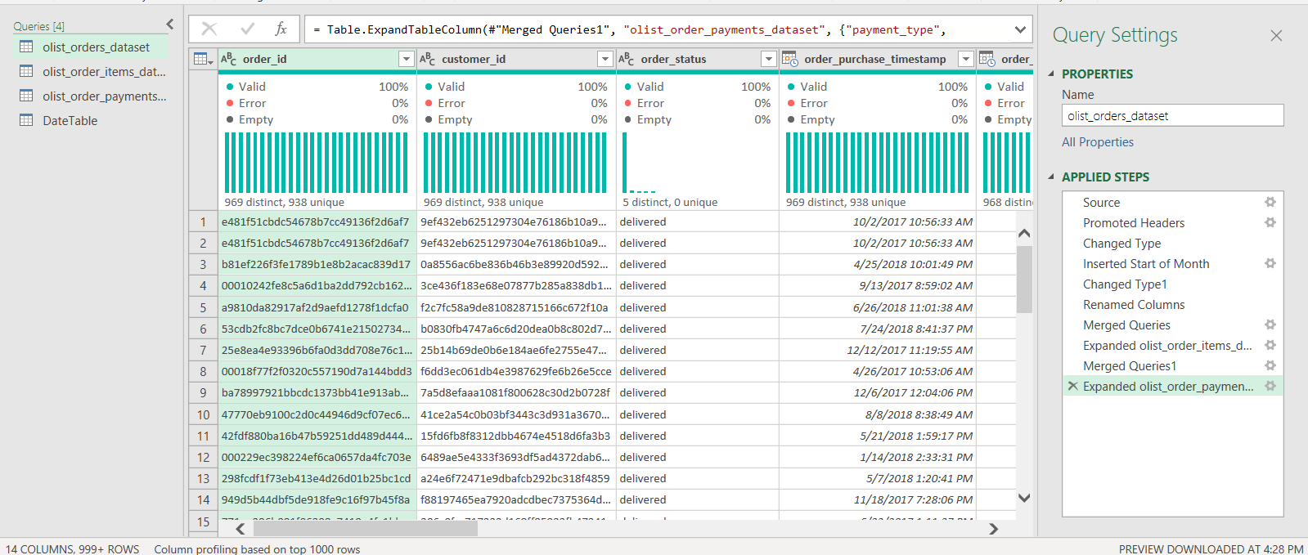
DATA PREPARATION
Data Cleaning in Power Query
Raw Import Problems
Cleaning Actions Applied
5 date columns loaded as text, not Date/Time (purchase, approved, carrier, delivered, estimated)
Payment table contained invalid "not_defined" payment_type rows
Merging tables created a duplicate Payment_Type.1 column
Items table had one row per line item, not one row per order
Changed Type step applied to all 5 date columns → Date/Time
Filtered Rows step removes not_defined payment records before grouping
Removed Columns step drops the duplicate Payment_Type.1 after the merge
Grouped Rows (Group By order_id) collapses items to one row per order
Evidence from the Applied Steps Panel
Payments query — Filtered Rows → Grouped Rows → Removed Columns (Payment_Type.1)
Orders query — Changed Type steps precede the merges that build the master table
LedgerSight
04

Slide 5
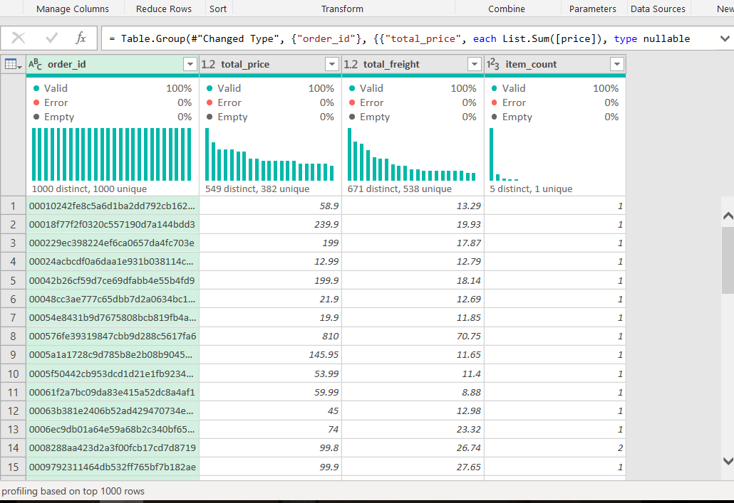
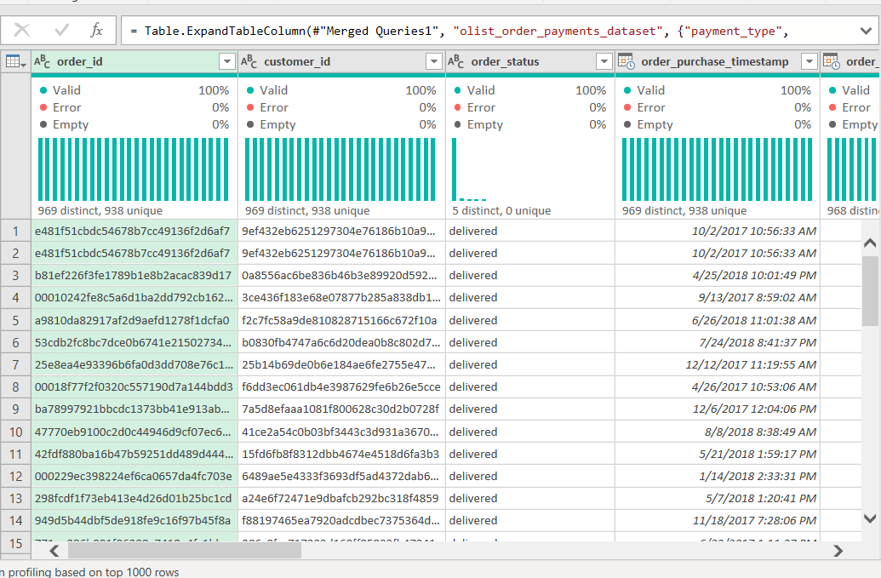
TRANSFORMATION
Power Query Workflow
Group By aggregation on both satellite tables, then a Left Outer Join into Orders — twice.
Items grouped by order_id → SUM(price), SUM(freight_value), COUNT rows
Orders after both merges — 14+ columns, order-level items & payment_type expanded in
1
2
3
4
Group By
Merge Queries
Expand Columns
Merge + Expand #2
Items → sum price/freight, count rows · Payments → sum payment_value
order_id (Orders) ↔ order_id (aggregated Items) — Join Kind: Left Outer
total_price, total_freight, item_count pulled into Orders, prefix removed
Repeat with aggregated Payments → adds payment_type, total_payment
Row-count check: 98,666 items rows + 101,683 payment rows merge into Orders without inflating it — the master table holds steady at 101,687 rows.
LedgerSight
05

Slide 6
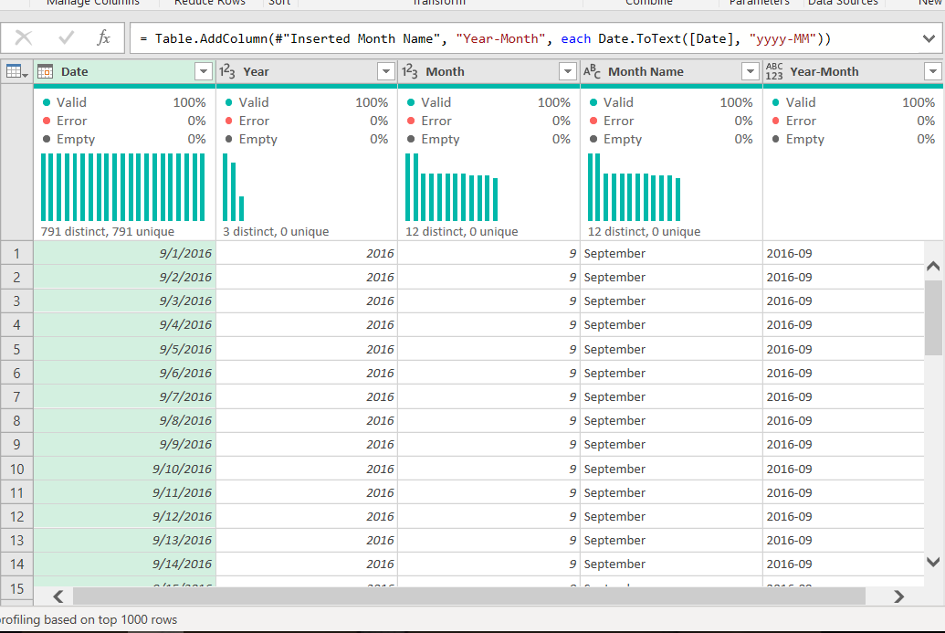
DATA MODEL
From Raw Tables to a Master Table
RAW TABLES
DATE DIMENSION
Orders
(dates, status)
Order Items
(price/freight)
Order Payments
(payment_value)
AGGREGATED TABLES
Items grouped by
order_id → 98,666 rows
Payments grouped by
order_id → 101,683 rows
ANALYTICAL MASTER TABLE
MasterTable — 101,687 rows, 20 columns
Orders + Items + Payments, one row per order
A custom DateTable (791 dates, Year / Month / Month Name / Year-Month) is built independently in Power Query and marked as the Date Table in Power Pivot — required for DAX time-intelligence like MoM Growth %.
Why this structure?
Aggregating before joining keeps the merge at order-level grain — one row per order — so every downstream DAX measure and PivotTable counts orders correctly instead of double-counting line items or installments.
LedgerSight
06

Slide 7
MASTER TABLE LAYER
Calculated Columns
Six helper columns added to the master table — computed once per row, ready for every DAX measure that follows.
Total_Order_Value
Net_Profit
Gross_Margin_Pct
=[@total_price]+[@total_freight]
=[@total_price]-[@total_freight]
=IF([@Total_Order_Value]=0,0,
[@Net_Profit]/[@Total_Order_Value]*100)
Full order value including shipping — the basis for revenue measures.
Item value net of freight cost — feeds the profitability analysis.
Profitability as a percentage of order value, guarded against divide-by-zero.
is_late
Delay_Days
Payment_Diff
=IF([@order_delivered_customer_date]="",FALSE,
[@order_delivered_customer_date]>
[@order_estimated_delivery_date])
=IF([@order_delivered_customer_date]="",0,
[@order_delivered_customer_date]-
[@order_estimated_delivery_date])
=[@total_payment]-[@Total_Order_Value]
TRUE/FALSE flag used to isolate late deliveries in every delivery KPI.
Days late (or early) — averaged to produce Avg Delay Days.
Gap between what was paid and what the order was worth — payment control.
LedgerSight
07

Slide 8
SEMANTIC LAYER
Power Pivot + DAX Measures
The Hero Measure
Supporting Measures
Reconciliation %
$15,744,351.79
Total Revenue
CALCULATE(SUM(Total_Order_Value), order_status="delivered")
Reconciliation % :=
DIVIDE(
[Total Revenue],
[Expected Revenue], 0
) * 100
$16,064,567.48
Expected Revenue
CALCULATE(SUM(Total_Order_Value), order_status IN {delivered, shipped, invoiced, processing, approved})
How much of Expected Revenue actually landed as Total Revenue
$16,008,872.12
Total Payments
Displayed as the hero KPI card — 98.0% — bordered in orange and shown as a line on the revenue chart
SUM(MasterTable[total_payment])
7,981 orders
Late Deliveries
CALCULATE(COUNTROWS(MasterTable), is_late=TRUE, order_status="delivered")
9.6 days
Avg Delay Days
CALCULATE(AVERAGE(Delay_Days), is_late=TRUE, Delay_Days>0)
LedgerSight
08

Slide 9
KPI LAYER
The Numbers That Run the Business
$15.74M
$16.06M
98.0%
$16.01M
TOTAL REVENUE
EXPECTED REVENUE
% RECONCILIATION
TOTAL PAYMENTS
Delivered orders · $15,744,351.79
Approved-type orders · $16,064,567.48
Actual vs. Expected
$16,008,872.12 received
101,687
643
7,981
9.6 days
TOTAL ORDERS
CANCELED ORDERS
LATE DELIVERIES
AVG DELAY DAYS
Full master table
0.6% of total orders
8.1% of delivered orders
Average across late orders
Proof: the four primary KPI cards as they render live on the LedgerSight dashboard sheet
LedgerSight
09

Slide 10
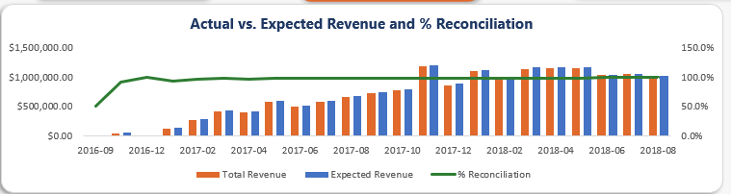
THE CORE DELIVERABLE
Financial Reconciliation
minus
equals
$16,064,567.48
$15,744,351.79
$320,215.69
EXPECTED REVENUE
TOTAL REVENUE (ACTUAL)
UNRECONCILED GAP (2.0%)
Reconciliation % := DIVIDE(Total Revenue, Expected Revenue, 0) × 100 → 98.0%
What the Gap Means
Reconciliation held ~98% for nearly the entire two-year window. The dip to 51.3% and 90.7% appears only in Sep-Oct 2016 — the marketplace's launch window with very low order volume, not a genuine performance issue in the steady state.
The remaining 2.0% gap ($320K) is the difference between orders that reached "delivered" and the broader set of approved-type orders still in the fulfilment pipeline at any given month.
Actual vs. Expected Revenue and % Reconciliation — full 2016-09 to 2018-08 window
LedgerSight
10

Slide 11
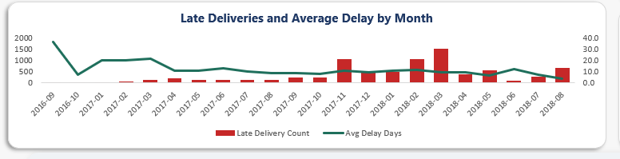
OPERATIONAL CONTROL
Delivery Performance
7,981
9.6 days
1,526
LATE DELIVERIES
AVG DELAY (GRAND TOTAL)
PEAK MONTH (MAR 2018)
8.1% of 98,660 delivered orders
Average across all late orders
Highest single-month late count
Reading the Trend
Late deliveries rose sharply from Nov 2017 (1,066) through Mar 2018 (1,526), while Avg Delay Days stayed in the 7-12 day band throughout — it did not spike alongside the count.
This pattern points to volume-driven strain on fulfilment capacity rather than a worsening delivery process — each late order isn't taking longer, there are simply more of them.
Late Deliveries and Average Delay by Month — bars = count, line = avg delay days
Why It Matters
Late deliveries erode customer trust and increase support and refund costs — flagging the Jan-Mar 2018 spike gives operations a specific, bounded window to investigate rather than a vague year-round concern.
LedgerSight
11

Slide 12
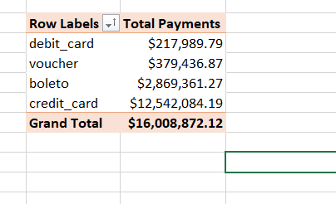
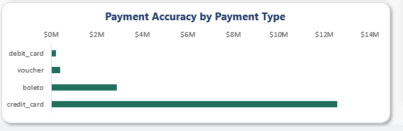
PAYMENT ACCURACY
Payment Control
Order Value vs. Payments Received
Payments Received by Payment Type
$16.06M
$16.01M
Credit Card
78.3%
Boleto
17.9%
EXPECTED REVENUE
TOTAL PAYMENTS
Voucher
2.4%
$16,008,872.12
Debit Card
1.4%
Payment shortfall vs. Expected Revenue: -$55,695.36 (-0.3%)
Payment Accuracy by Payment Type — credit_card and boleto together carry 96.2% of total payment value
Reconciliation Read
Total Payments ($16,008,872.12) run slightly below Expected Revenue ($16,064,567.48) — a $55,695 shortfall (-0.3%) — but sit above delivered-order Total Revenue ($15,744,351.79), since payments are collected across every approved-type status, not only fully delivered ones. Payment_Diff, the row-level calculated column, makes this order-by-order gap traceable.
LedgerSight
12

Slide 13
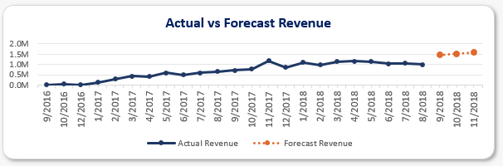
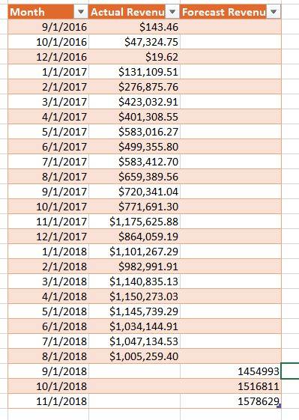
BONUS ANALYTICAL TASK
Revenue Forecasting
Using prior monthly revenue trends to project the next 3 months of sales and revenue growth.
Method
Actual vs. Forecast Revenue
A linear trend is fitted to the 24 months of Actual Revenue (Sep 2016 – Aug 2018) and extrapolated forward — the same logic as Excel's TREND / FORECAST.LINEAR function. The trend is remarkably steady: each forecast month adds a constant +$61,818 over the previous one.
3-Month Forecast
$1,454,993
$1,516,811
$1,578,629
Solid line = 24 months of actual revenue. Dotted line = 3-month linear forecast (Sep–Nov 2018).
SEP 2018
OCT 2018
NOV 2018
Why It Matters
Gives the business a data-backed expectation for next quarter's revenue, without waiting for the month to close — useful for planning and setting realistic monthly targets.
+$61,818 / month — constant linear growth projected forward, consistent with the steady 2018 revenue plateau seen in Slide 10.
Source table — Actual Revenue column feeds the trend; Forecast Revenue column holds the projection.
LedgerSight
13

Slide 14
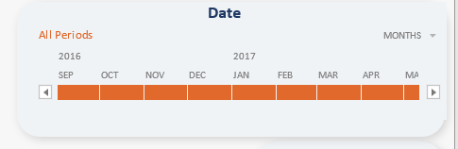
THE DELIVERABLE
The Live Dashboard — Overview
Actual screenshots from the LedgerSight.xlsx Dashboard sheet — nothing simulated.
① KPI CARDS
Four KPI cards, formula-linked to PivotTables — no hard-coded numbers
② DATE TIMELINE FILTER
③ KEY INSIGHTS STRIP
Report-connected to all four PivotTables and PivotCharts at once
Narrative callouts under the charts — findings, not just figures
Every KPI card and every chart on this dashboard responds to the same Timeline and Slicers — filtering to a single month, status, or payment type updates all four PivotCharts simultaneously.
LedgerSight
14

Slide 15
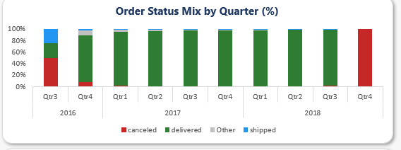
THE DELIVERABLE
The Live Dashboard — Charts
1. Revenue Overview
2. Order Status Mix
Combo: Total & Expected Revenue (columns) + % Reconciliation (line, secondary axis)
100% stacked column by quarter — delivered / canceled / shipped / Other
3. Delivery Insights
4. Payment Accuracy
Combo: Late Delivery Count (columns) + Avg Delay Days (line, secondary axis)
Horizontal bar, sorted descending by total payments per payment type
LedgerSight
15

Slide 16
FINDINGS
Key Insights
Straight from the dashboard's own Insights strip — every number traces back to a PivotTable.
98.0%
50% / 100%
1,526
WHAT IT MEANS
WHAT IT MEANS
WHAT IT MEANS
Reconciliation held ~98% throughout the two-year window, apart from Sep-Oct 2016.
Cancellation share spikes to 50% (Q3 2016, 2 of 4 orders) and 100% (Q4 2018, 4 of 4 orders).
Late deliveries rose sharply in Jan-Mar 2018, peaking at 1,526 in March.
WHY IT MATTERS
WHY IT MATTERS
WHY IT MATTERS
That early dip coincides with the platform's launch window — very low volume, not a genuine performance dip.
Both quarters have only 4 total orders, so a couple of cancellations swings the percentage — not a systemic cancellation issue across the 643 total canceled orders.
Avg Delay Days stayed stable (~9-10 days) across the same months — likely volume-driven, worth investigating fulfilment capacity.
LedgerSight
16

Slide 17
SO WHAT
Business Recommendations
RECONCILIATION
Investigate the remaining ~2% / $320K gap between Expected and Total Revenue — trace which approved-type orders never convert to "delivered", and why.
DELIVERY
Investigate the Jan-Mar 2018 late-delivery spike (1,057-1,526 orders/month) for capacity or logistics causes, even though average delay per order held steady.
CANCELLATIONS
Monitor cancellation share by month, not just by count — the Q3 2016 / Q4 2018 spikes are low-volume artifacts, not a rising cancellation rate.
PAYMENTS
Boleto and credit_card together represent 96.2% of payment value ($15.41M of $16.01M) — prioritize reconciliation checks on these two payment types first.
MONITORING
Operationalize this workbook as a recurring monthly-close tool: refresh the queries, re-verify % Reconciliation, and re-run the 3-click filter demo each period.
LedgerSight
17

Slide 18
UNDER QUESTIONING
Technical Defensibility
Excel
Power Query
Power Pivot
DAX
PivotTables /
PivotCharts
Dashboard
Validation Checks Actually Performed
Anticipated Judge Questions
Row count held at 101,687 through both Left Outer Joins — verified in the query preview after each merge
Every KPI card is cell-linked to a PivotTable / DAX measure — zero hard-coded values on the Dashboard sheet
Timeline and both Slicers connected via Report Connections to all four PivotTables simultaneously
Data → Refresh All re-run after file close/reopen to confirm the model rebuilds identically
Q: Why does % Reconciliation dip in a given month?
A: It's driven by the Expected Revenue denominator (all approved-type statuses) vs. the Total Revenue numerator (delivered only) — a low-volume month exaggerates the ratio.
Q: How did you define "Approved Orders"?
A: Expected Revenue = delivered + shipped + invoiced + processing + approved — every status past initial order creation, per the DAX measure.
LedgerSight
18

Slide 19
FINAL TAKEAWAY
From raw transactions
to measurable business control.
98.0%
101,687
$15.74M
RECONCILIATION
ORDERS PROCESSED
REVENUE CONTROLLED
LedgerSight · Built entirely in Excel — Power Query, Power Pivot, DAX, PivotTables & PivotCharts. No external tools.

